Slide 1

Motivating Employees

Slide 2

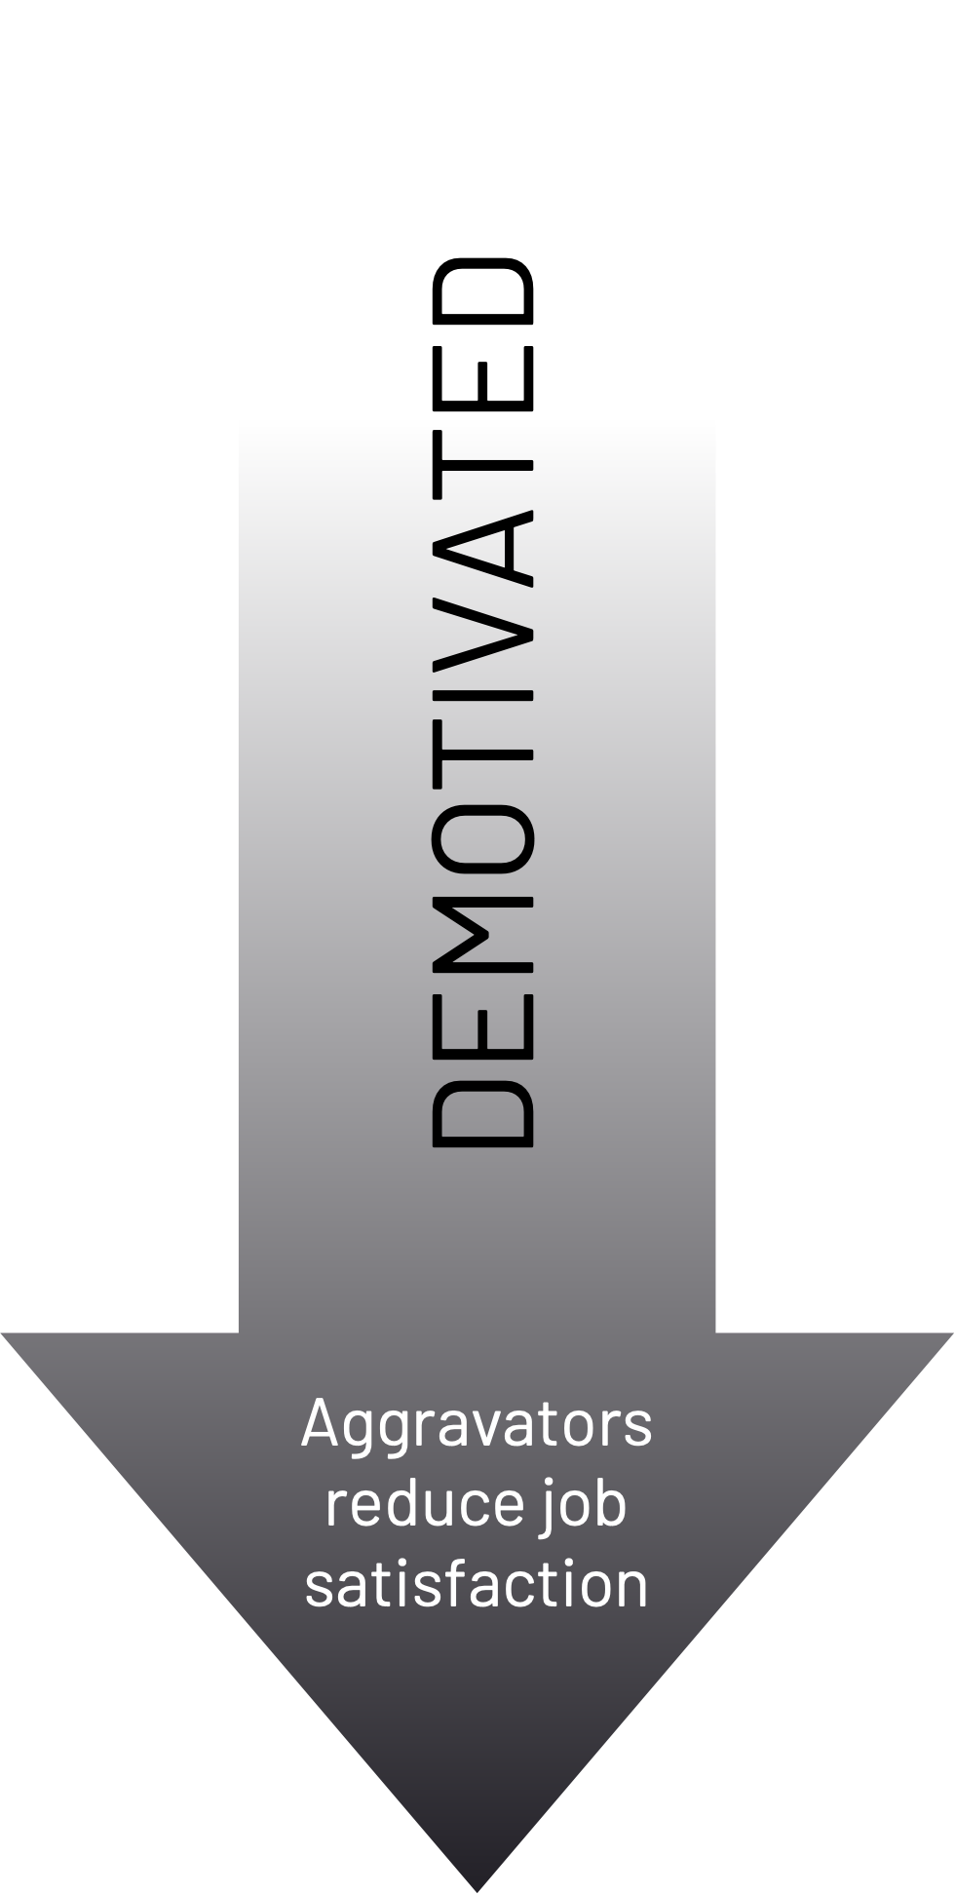
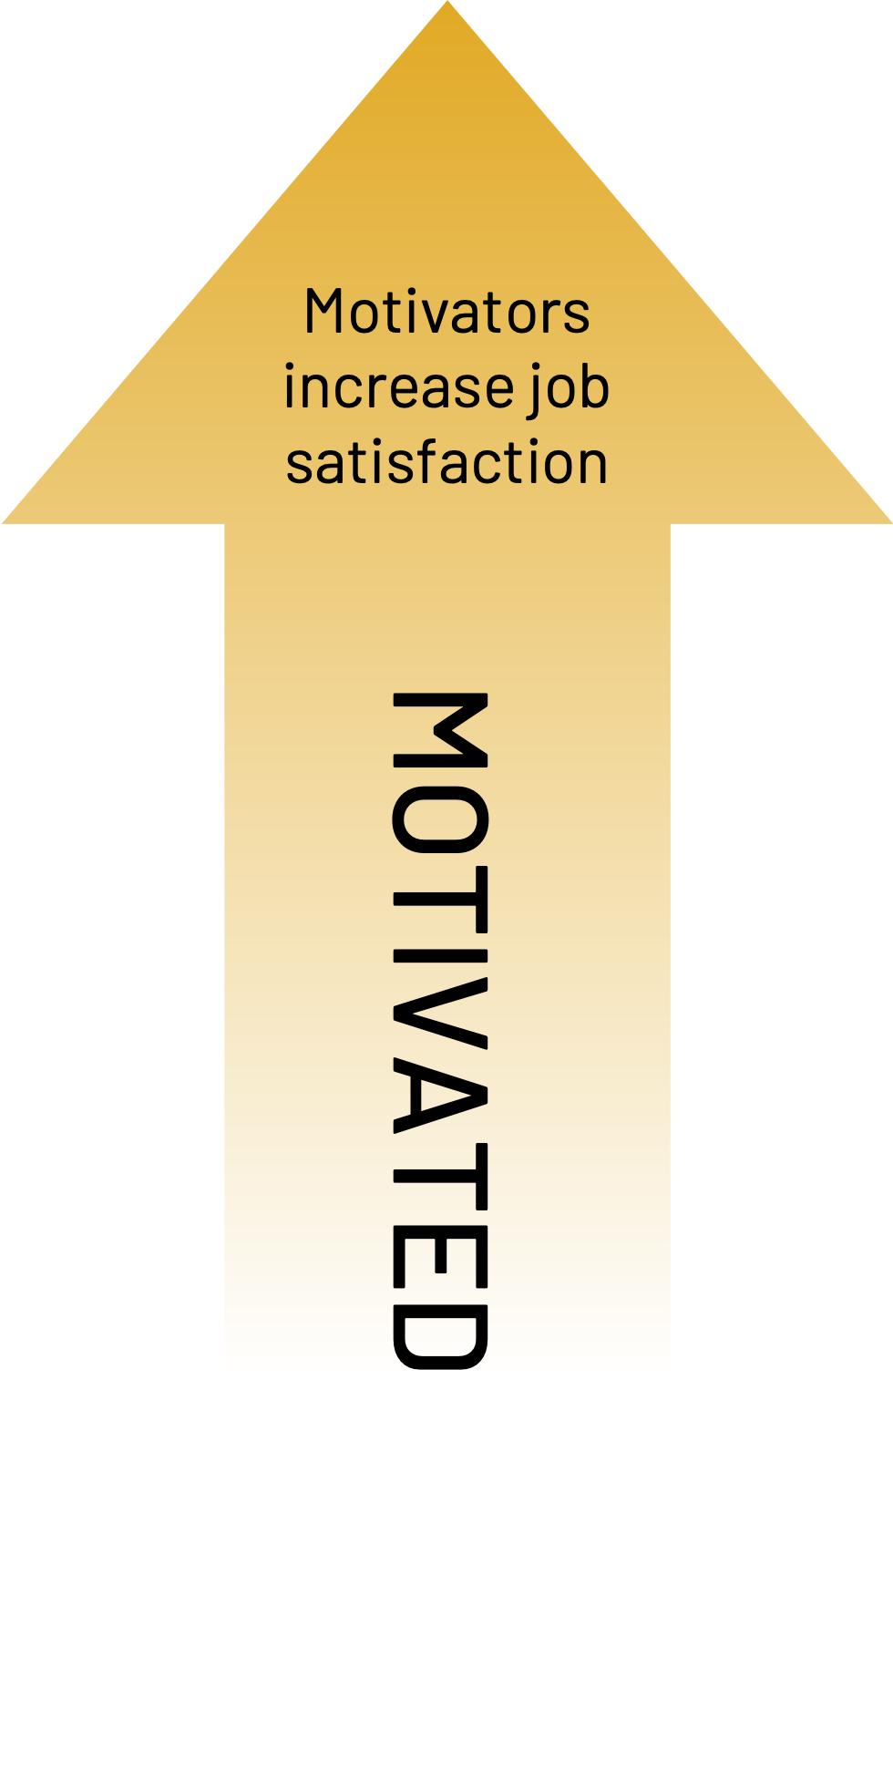

Motivating Employees
Motivating employees is not as simple as handing out the occasional bonus or saying “Good job!” A great deal of research and practice has shown that two separate sets of factors affect employee motivation:
Motivators are the factors that cause employees to be satisfied with and engaged in their jobs. Leaders must ensure that the motivators are present if they want employees to be intrinsically motivated in the long term.
Aggravators are the factors that destroy motivation. When an aggravating factor is present, the employee experiences an obstacle to full satisfaction with and engagement in their job.
The key point to remember is that removing aggravators does not create motivation. CEOs and other leaders should work to eradicate these aggravating factors, but they should not mistakenly believe that doing so will result in a motivated workforce. Instead, they should remove aggravators while also ensuring that the motivators are present. Aggravators tend to be things like poor company policy, pay structures, and work conditions; the CEO and executive leadership team are most responsible for directly addressing these. Meanwhile, motivators are factors like achievement, recognition, and opportunity for growth, which managers at all levels can affect.
Salary is a good example of an aggravator. If the employee is not paid enough, they will have an obstacle to motivation. But salary should not be thought of as a motivator. Once an employee is paid the amount they deem fair, pay does not become a source of intrinsic motivation.

Slide 3


Strategies for Motivation
What follows are lists of the top motivators and aggravators of employees as identified by two-factor theory and outlined in Harvard Business Review. Think through each one and write down an action you and/or other leaders in the organization can take to reinforce motivators and remove aggravators.
Motivators
Achievement
Recognition
Work Itself
Responsibility
Opportunity for Advancement & Growth
Aggravators
Company Policy
Supervision/Relationship with Supervisor
Work Conditions
Salary
Relationship with Peers

