Slide 1

Mission, Vision
& Values

Slide 2

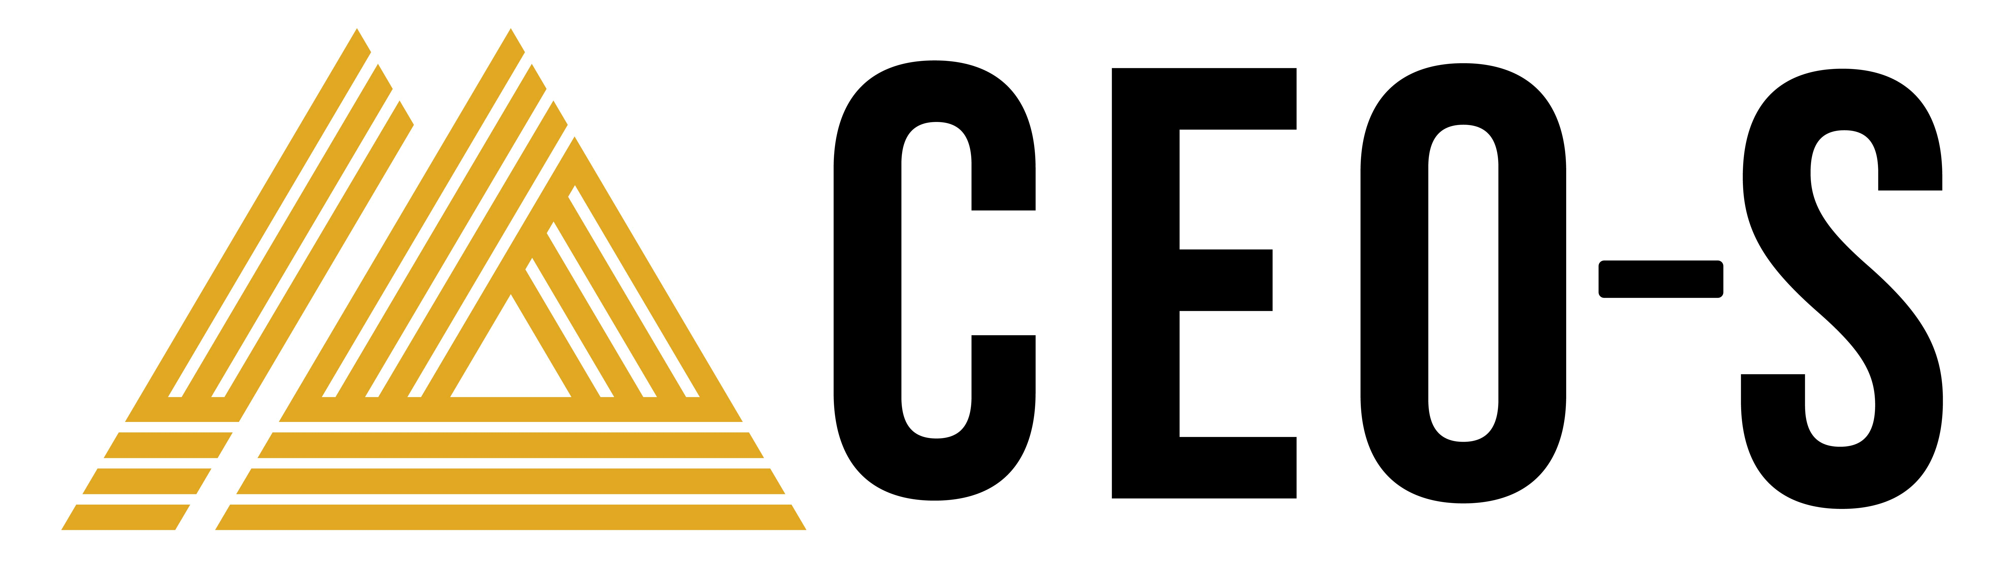
Create Your Mission, Vision & Values
As CEO, you must own your company’s mission, vision, and values. You may not be solely responsible for creating them, but it’s your responsibility to hone them, communicate them, and make them part of the organizational DNA.
A compelling mission, vision, and set of values influences all the outcomes you care about, from attracting new customers to bringing in top talent to ensuring that all parts of the organization are aligned around a shared understanding of success.
We encourage you to evaluate your current mission statement, vision statement, and values using the following guidelines, or to create them afresh if they are old or nonexistent. Once refined, they will go at the top of your 1-Page Strategic Plan.
1. Mission Statement
The mission statement is an expression of the organization’s core purpose. The mission statement should be memorable and easy to restate. It should be something that helps any stakeholder quickly identify with the organization and see exactly why it needs to exist. For example, Hyatt’s mission statement is “To provide authentic hospitality by making a difference in the lives of the people we touch every day.”
Key questions to consider as you draft your mission statement include:
Why do we go to work every day?
What makes us different from everyone else?
What is the essence of what we’re trying to achieve?

Slide 3
2. Vision Statement
The vision statement expresses the idealized state your organization will create if it achieves its mission. It should be both aspirational and inspirational, as well as easy to remember. Consider for example Habitat for Humanity’s vision statement: “A world where everyone has a decent place to live.” In a few simple, memorable words, this describes what the world will look like if the team executes its mission.
Key questions to consider as you craft or edit your mission statement include:
What role in the world do we want this organization to play?
How will people live differently if our organization is successful?
2. Differentiating Values
Your organization’s values are the principles that guide decisions and actions at every level of the workforce. A good set of values promotes autonomy while also building a sense of relatedness.
We call these differentiating values because we want you to choose values that are specific and unique—and not just general virtues. Rather than writing down generic and expected concepts like honesty, integrity, or quality, think about the trade-offs your employees must make day to day and what values should guide their decision making. Remember, these are values (someone else might choose to do the opposite), not virtues (everyone agrees on and expects these).

